Slide 1
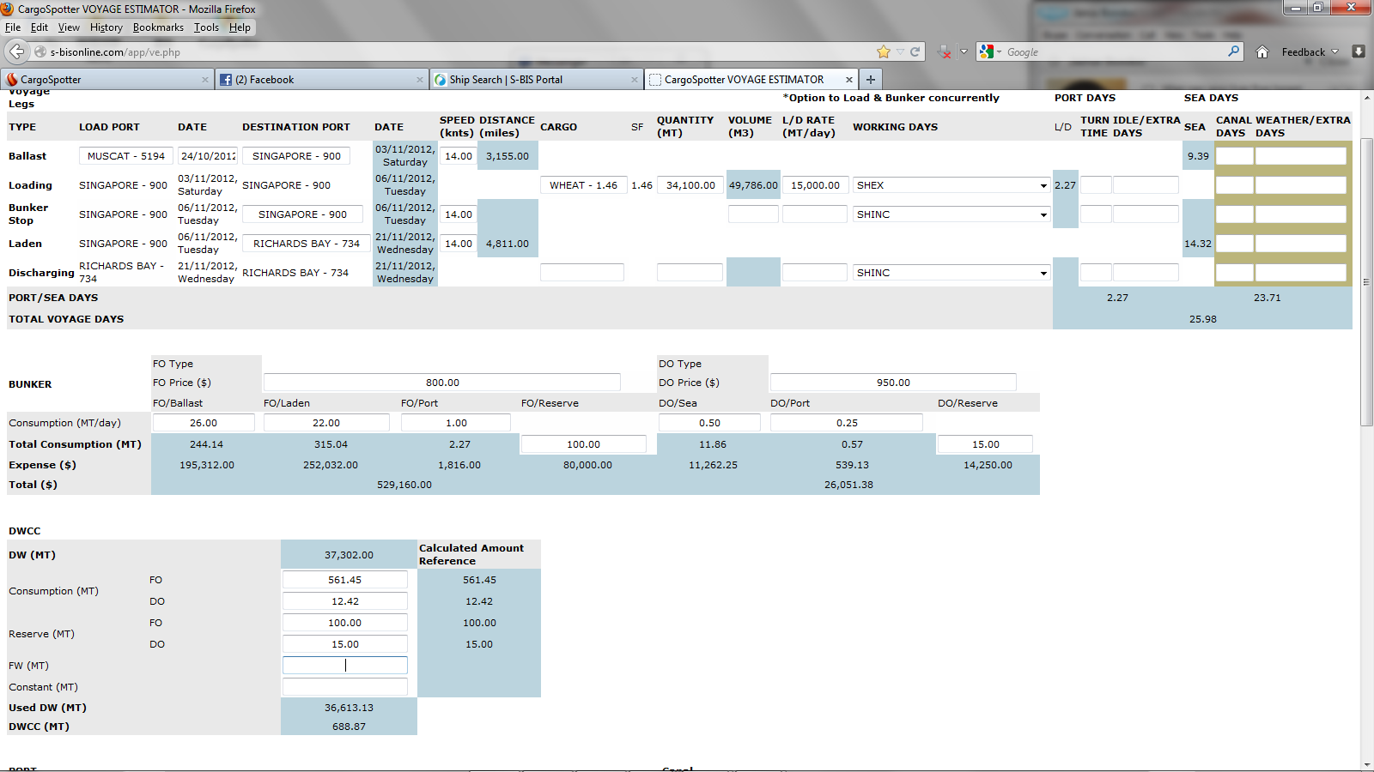
Used is 688.87 DWCC is the DW - Used
Fields the wrong way around

Slide 2
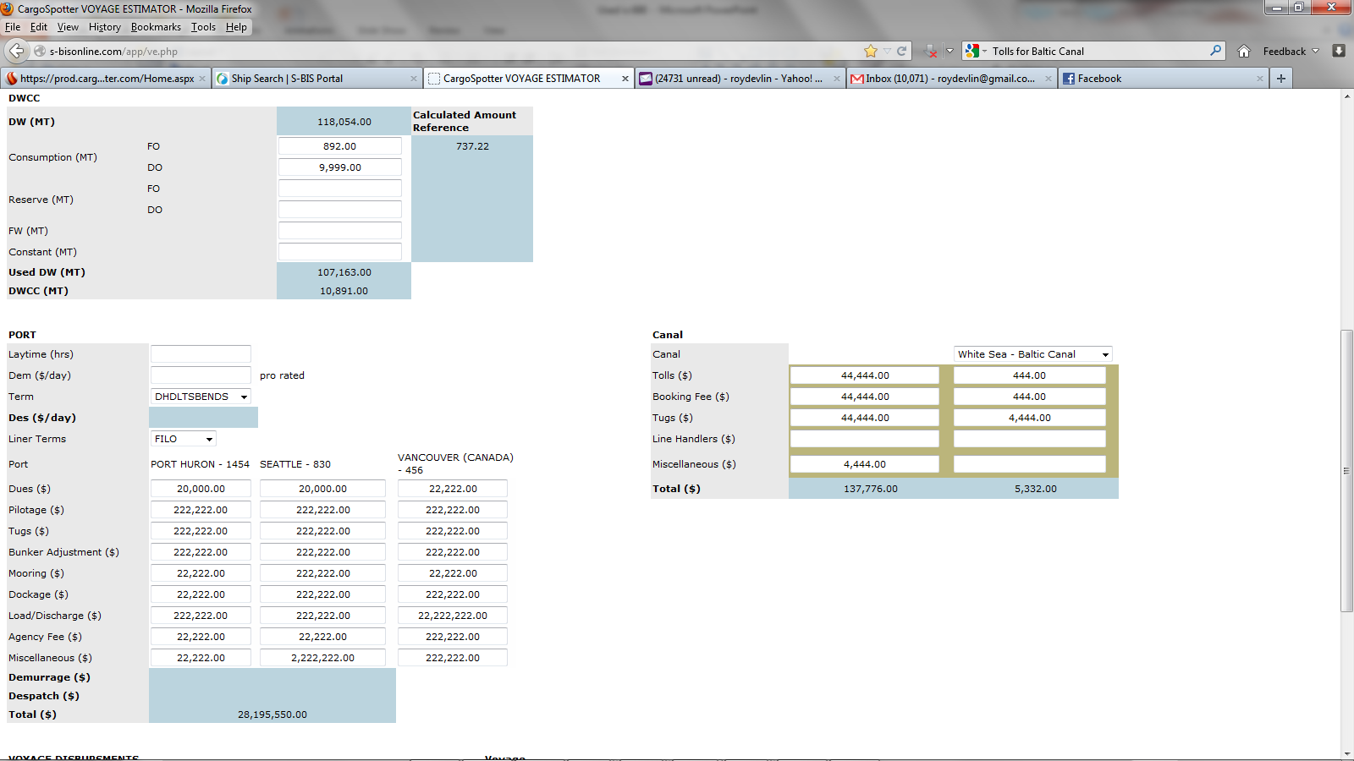
Demurrage and Dispatch
No calculations working
Demurrage is not calculating
=IF(O32+O33+O35-C51/24>0,(O32+O33+O35-C51/24)*C52,0)
Dispatch seems to work.
='[VE Tech Spec Sheet (2).xls]VE PRO'!$C$67:$D$67

